Slide 1
Fiction Horror or Real Horror?
NLP: Reddit Subreddit classification
Vivian Nguyen - DSIR 824

Slide 2
Subreddits:
r/nosleep
r/legaladvice

Slide 3
Excerpts: Try to guess
Have you ever had a memory that you remember so vividly, as if it happened the day before? You swear by every inch of your being that it happened. You remember just enough of the memory to trace it back to its origin, but then you realize....... it was a dream. You put your whole existence on the line, you were so positive, but in the end it was fake. This raises the question, what is real, and what is just a dream?
I’ll try to keep this as brief as possible. My husband is in a local union. Last week, his company discussed lay offs and asked if everyone would be ok with 32 hour paychecks for a few weeks to keep from having to do a large lay off. They all agreed that half of the employees would take Monday off and half would take Friday. My husband was off Monday. Today, they figured out that there was a miscommunication from up above and the compromise ...

Slide 4
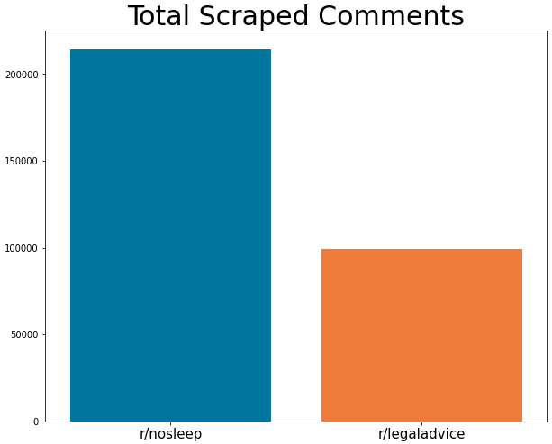
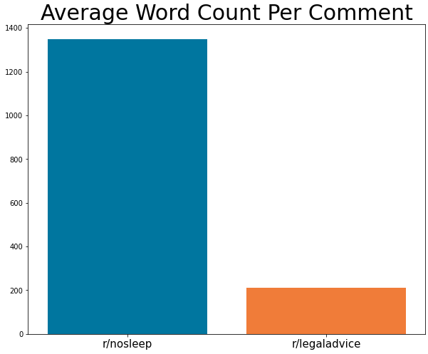
It’s All About The Data
Date Collected: 10/01/2020 - 10/02/2020

Slide 5

Reddit Scraping: A Technical Briefer
API: Pushshift
Batch Scrape: 1000 Comments
Wait Time: 5 Seconds
https://github.com/pushshift/api

Slide 6
No Lemma vs Lemma
A classmate and I have been working on a tech company for the past 10 months. I came up with the idea and have taken on all business roles for the company. He is a systems engineer. He’s built out most of the actual software. Problem is that we’re pretty good friends and have mutually agreed that a fifty fifty split would be fair in the past. Now, we’ve both agreed that equity should not be split fifty fifty because of potential future disagreements in the future there needs to be a clear decision maker. I brought it up, and he agrees. What’s the best route for determining current equity stakes, especially if we think we will bring on two more people before raising our first round?'
a classmate and i have been working on a tech company for the past 10 month i came up with the idea and have taken on all business role for the company he is a system engineer he s built out most of the actual software problem is that we re pretty good friend and have mutually agreed that a fifty fifty split would be fair in the past now we ve both agreed that equity should not be split fifty fifty because of potential future disagreement in the future there need to be a clear decision maker i brought it up and he agrees what s the best route for determining current equity stake especially if we think we will bring on two more people before raising our first round'

Slide 7
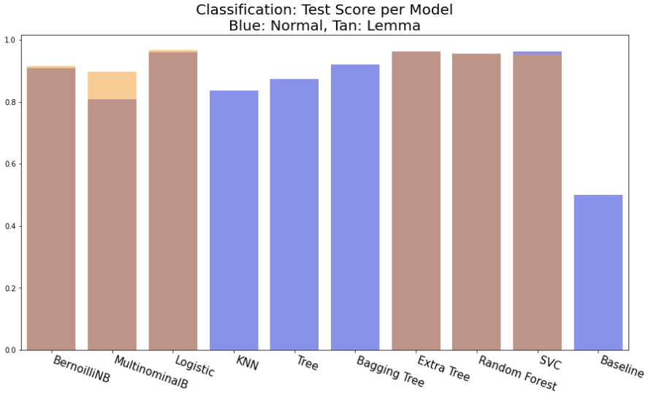
Model
Performance

Slide 8
Let’s try it!
My town has a bit of mystery to it. Flattsville, located right off of route 303 has a history to it of a sinister nature. We are a small knit community, approximately 800 residences. Flattsville serves as more as stop off on route 303, where truckers come in for cheap liquor and dusty old motels. There isn’t a whole lot of business to find here, especially as an up and coming novelist. I am taking the time now to send out some information, hoping someone out there can explain what the hell is going on in Flattsville.
Both of our names will be on the birth certificate. We used an anonymous, non-ID donor from a sperm bank for conception. So I will not be biologically related to him. Friends of ours have different thoughts on what is required here, I don’t see what adopting him would do that being on his birth certificate doesn’t, but I can’t seem to find any information about it. Any help or advice would be appreciated.
Date Collected: 10/09/2020

Slide 9
Model Results
Legal Advice
Legal Advice

Slide 10
Thoughts and Conclusions
Still not Generalizable Enough

